Slide 1
A Proposed Standard for Entity Attestation Laurence Lundblade July 2018

Slide 2

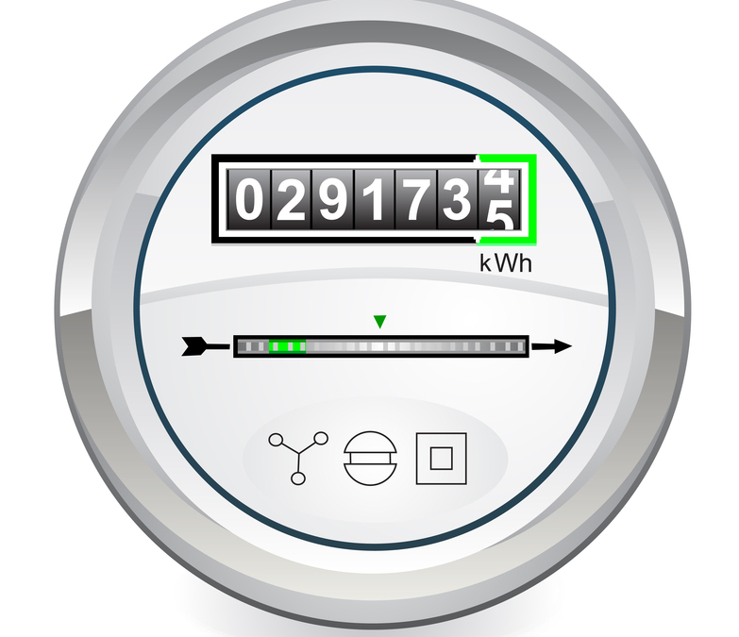

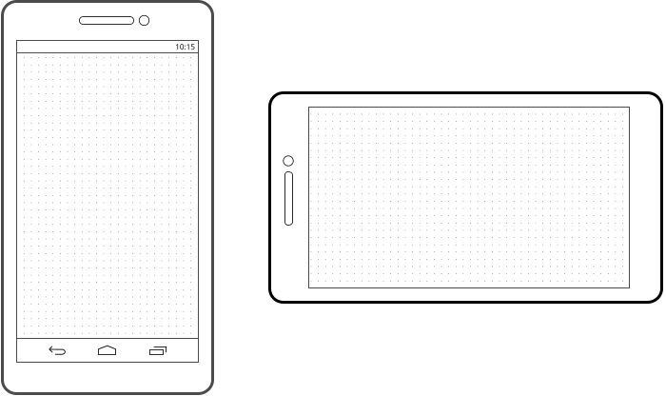
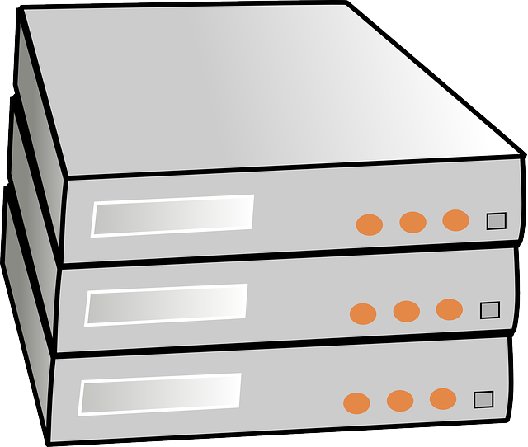
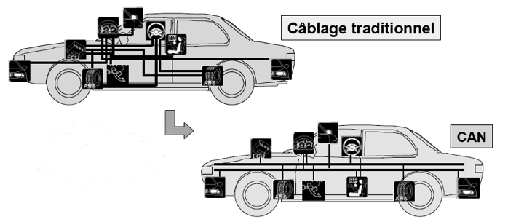
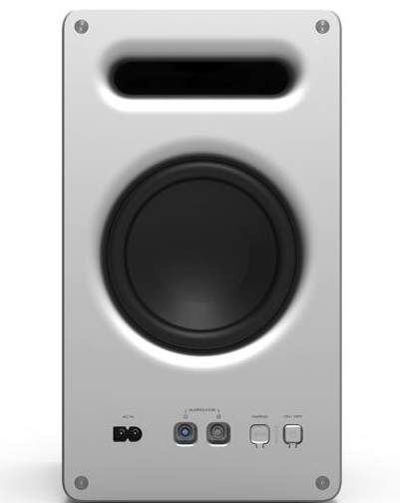
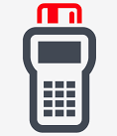
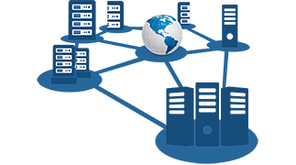


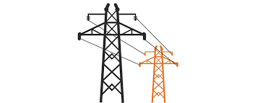
Entity
Attestation
Token
Good Devices
Chip & device manufacturer
Device ID (e.g. serial number)
Boot state, debug state…
Firmware, OS & app names and versions
Geographic location
Measurement,rooting & malware detection…
All Are Optional
Banking risk engine
IoT backend
Network infrastructure
Car components
Emulating
Real Device
Tampered
Bad Devices
Rooted
Cryptographically secured by signing
Cloned
Enterprise auth risk engine
Electric company

Slide 3
End-End Attestation Flow
Entity Manufacturer
(e.g. chip or device vendor)
Provision private keys during manufacturing
Entity (e.g., Chip, Device…)
Verification Keys
Private key for signing. Stored securely on device
Self-secured token carried in protocol messages
Claims data
Relying Party (e.g., Server / Service)
Token Creation and Signing
Verification Process
Processing such as a payment or authentication risk engine
EAT Token
Verified claims
Other flows are possible where verification is done by a service or by the entity vendor.

Slide 4
Entity Attestation Token
Four Aspects of Standardization
1. General Structuring and Representation of Claims Labeling of claims Optionality of claims Flexible data representation – integers, strings, binary…
2. Meaning of Individual Claims Interoperability between devices and servers from different vendors
3. Signing Format Accommodate different schemes and algorithms
4. Encryption Format (optional) Accommodate different algorithms
Claim 1: value
Claim 2: value
Claim 3: value
…
Cryptographically secured by signing
Optional Encryption

Slide 5
EAT Format
COSE format for signing
Small message size for IoT
Allows for varying signing algorithms, carries headers, sets overall format
Overall structure: COSE_Sign1
Algorithm -- Examples: ECDSA 256, RSA 2048, ECDAA
Signing Scheme -- Examples: IEEE IDevID, EPID, X.509 Hierarchy
protected
headers
CBOR format for claims
Small message size for IoT
Labelling of claims
Very flexible data types for all kinds of different claims.
Translates to JSON
Key ID -- identifies the key needed to verify signature
Certs (optional) -- to chain up to a root for some signing schemes
unprotected
headers
CBOR formatted map of claims that describe device and its disposition
Few and simple or many, complex, nested…
All claims are optional -- no minimal set
The format and meaning of a basic set of claims should be standardized for interoperability
Should be adaptable to cover many different use cases from tiny IoT devices to complex mobile phones
Privacy issues must be taken into account
Signature proves device and claims (critical)
Accommodate different end-end signing schemes because of device manufacturing issues
Privacy requirements also drive variance in signing schemes
Signed payload
sig
signature -- Examples: 64 byte ECDSA signature, 256 byte RSA signature

Slide 6
Standardization / Extensibility of Claims
Base standard describes how claims work and are formatted in general and
May include the most common, best agreed upon claims
No claims will be mandatory in base standard
Verifiers can reject tokens missing claims required in specific use cases
Profile with minimum sets of claims can be defined, by industry / use case (automotive, power meter…)
Non-standard and proprietary claims will be allowed
Verifiers can ignore claims they do not understand
The bulk of standardization work will be defining claims well
Standardized meaning will allow verifiers to interpret claims from devices from different vendors
This will not always work perfectly and the meaning of some claims may be subjective
IANA (Internet Assigned Names and Numbers) can be used to register claims to avoid collisions and duplications. Similar registries already exist (e.g. CWT and JWT registries).
CBOR itself is extensible for new data types.

Slide 7
Example Token
COSE binary ~130 bytes including sig
COSE ECDSA signing overhead is about 87 bytes: 23 for headers and structure, 64 bytes for ECDSA sig
JSON text ~500 bytes including a JOSE sig
CBOR diagnostic representation of binary data of full signed token
Payload Translated to JSON
Integer labels mapped to strings
Binary data base 64 encoded
Floating point numbers turned into strings
{
“UEID” : “k8if9d98Mk979077L38Uw34kKFRHJgd18f==”,
“secureBoot” : true,
“debugDisable” : true,
“integrity”: {
“status”: true,
“timestamp”: “2015-10-5T05:09:04Z”,
},
“location”: {
“lat”: “32.9024843386”,
“long”: “-117.192956976”,
},
}
[
/ protected / << {
/ alg / 1: -7 / ECDSA 256 /
} >>,
/ unprotected / {
/ kid / 4: h'4173796d6d65747269634543445341323536’
},
/ payload / << {
/ UEID / 8: h'5427c1ff28d23fbad1f29c4c7c6a55’,
/ secure boot enabled / 13: true
/ debug disabled / 15: true
/ integrity / -81000: {
/ status / -81001: true
/ timestamp / 21: 1444064944,
},
/ location / 18: {
/ lat / 19: 32.9024843386,
/ long / 20: -117.192956976
},
} >>,
/ signature / h'5427c1ff28d23fbad1f29c4c7c6a555e601d6fa29f9179bc3d7438bacaca5acd08c8
d4d4f96131680c429a01f85951ecee743a52b9b63632c57209120e1c9e30'
]

Slide 8
Device and Submodules
A top-level token is associated with a device – a finished commercial end product
A device may have a set of submodules
Examples: WiFi subsystem, DSP subsystem
A submodule has a set of claims of its own
One level of submodules – keep it simple
The security of a submodule is either the same or less than that of the device
Tokens may be nested
This allows submodules that have attestation keys to create their own attestations

Slide 9
COSE Signing Scheme Flexibility
Many standard algorithms already supported
RSA, ECDSA and Edwards-Curve Signing (public key)
HMAC and AES-based MACs (symmetric key)
Extensible for future algorithms
IANA registry for algorithms exists today
Extensible for special case schemes
Proprietary simple HMACs schemes, perhaps HW based
Possibly Intel EPID
(non-standard algorithms will of course be less interoperable)

Slide 10
Privacy
Entity Attestation Tokens are intended for many use cases with varying privacy requirements
Some will be simple with only 2 or 3 claims, others may have 100 claims
Simple, single-use IoT devices, have fewer privacy issues and may be able to include claims that complex devices like Android phones cannot
Options for handling privacy
Omit privacy-violating claims
Redesign claims especially to work with privacy regulation
Obtain user permission to include claims that would otherwise be privacy-violating
Some signing schemes will be privacy-preserving (e.g. group key, ECDAA) and some will not

Slide 11
Similar and Related Technologies
Technology | Use Case
FIDO Attestation | Attestation of FIDO Authenticator implementations
Android Key Store | Attestation key pairs in the key store
NEA | Collect and send endpoint security posture (e.g. anti-virus SW state and config) to enterprise collection / monitoring point
RATS / NSF | Attestation / Measurement of SW on Network Security Functions (e.g., firewalls)
TPM | Attestation / Measurement of SW running on a device
BRSKI / Zero Touch | Authenticates IoT devices for enrollment in IoT management system

Slide 12
More Info
Non-WG mailing list: eat@ietf.org
Mail list info: https://www.ietf.org/mailman/listinfo/EAT
Draft document: https://tools.ietf.org/html/draft-mandyam-eat-00
Github: https://github.com/eat-ietf-wg

Slide 13
Extra Slides Follow

Slide 14
Encryption Format
COSE allows for signed data to be encrypted, vice versa (and even countersigning)
CBOR encryption provides algorithm flexibility, structuring and so-on like it does for signing.
Specifies how to combine AES symmetric encryption with EC or RSA public key
Encryption of tokens is optional, but useful
Protect data that needs to be secret
Useful in implementing a privacy proxy
Monetization of an attestation service

Slide 15
End-end Attestation Flow – Two scenarios
Device / Chip Vendor
Device / Chip Vendor
Verification Process
Provisions private keys during manufacturing
Provisions private keys during manufacturing
Token
Verification Keys
Device / Chip
Verified payload
Device / Chip
Token – Sent for verification
Token – Carried in protocol messages
Token – Carried in protocol messages
Relying Party
Relying Party
Token
Token
Verification Process
Verified payload
1. Device / Chip Vendor Provides a Service
2. Device / Chip Vendor Provides Keys

Slide 16
Signing Format
COSE_Sign1: a CBOR array of four
protected
headers
Algorithm : ECDSA 256
unprotected
headers
Key id : d25a91aef0b0117e2af9a291 aa32e14ab834dc56ed2a223444547e01
COSE (CBOR Object Signing and Encryption) RFC 8152
COSE is an IoT-oriented format for signing and/or encrypting a payload. It is similar to, but much simpler and more compact than PKCS #7, CMS and JOSE
CBOR formatted map of claims
Maybe small and simple or large, nested and complex
payload
sig
bstr – 64 bytes of ECDSA signature
COSE signed tokens are small, self-secured data blobs that can be embedded in other protocols or written to disk…
COSE provides structuring of payload (to-be-signed data), algorithm identification, key identification and signature
Standard format allows use and development of standard / open source tools

Slide 17
General Structure & Representation of Claims
CBOR (Concise Binary Object Representation) RFC 7049
Integers, text, binary, floating point numbers…
Aggregate types: arrays, maps of label-value pairs
Reasonably mature – On IETF Standards Track, RFC 7049 published in 2013
Open source implementations and tools available in many languages at http://cbor.io
Translatable to JSON by common tools
Compact code and data for IoT
Meets goal:
Top-level of token payload is a CBOR map of label-value pairs
CBOR maps easily allow for optional data
CBOR data types are simple & powerful – a top-level claim can be a simple integer or have a complex internal structure

